Slide 1
Anticipatory governance in urban decision making processes
Sietske Veenman, Peter Ache, Linda Carton
Vincent Marchau, Etiënne Rouwette, Sietske Veenman

Slide 2
Two in one (1)
Abstract 1: Veenman, Marchau and Rouwette
  Context, main questions, concepts, case, preliminary observations
Abstract 2: Veenman, Ache and Carton
  Context, focus, concepts, case and preliminary observations

Slide 3
Two in one (2)
Similarities
Both use the framework of Quay (2010) as starting point
Both critically enquire and theoretically adjust this theoretical basis
Both have Nijmegen (city) as case study
Differences
Different focus:
  Methods of adaptive planning and the onfluence on governance (Marchau Rouwette and Veenman)
  Role of citizens in (Veenman, Ache and Carton)
Different scientific philosophy

Slide 4
Two in one (3)
AG | Adaptive planning | Citizen-Sensor-Network
Future Analysis
Adaptation Strategies
Monitoring & Action
Notes:
anticipation and futures analysis, creating flexible adaption strategies and monitoring & action

Slide 5
Context and focus adaptive planning (1)
Relying on forecasts and a range of futures with bandwiths has shortcommings
Develop anticipatory approaches by providing a planning framework:
  monitoring
  ability to adapt
  fully exploits new knowledge

Slide 6
Context and focus adaptive planning (2)
Adaptive planning originates from ‘Decision making Under Deep Uncertainty’ (wicked problems)
We take into account the lessons of Quay (2010)
The concept of Anticipatory Governance → focus upon governance
Case study: Nijmegen (mainly still to be done)

Slide 7
Main questions
How does anticipatory governance might take place in practice, focussing upon
  How might existing decisionmaking processes be adjusted to enable the implementation of adaptive plans?
What does adaptive planning mean for governance arrangements?

Slide 8
Anticipatory governance
Builds on the framework of Quay (2010):
  Envisioning and anticipate different futures
  Engagement and formulate adaptation strategies
  Integration of results: integrating and monitoring & action
And his lessons:
  Further research how to use a wide range of scenario’s
  Develop flexible strategies that can be initiated
  Develop a monitoring system
  Institutionalize flexible decision-making frameworks

Slide 9
Adaptive planning
Basic principles of adaptive plans
    Anticipate a wide range of possible futures
    Develop multiple urban strategies
    Monitor changing conditions over time
    Implement anticipated policies and evaluations

Slide 10

Adaptive planning – basic steps
Start with promising basic plan
Protect basic plan and adjust in case needed (anticipate, prepare & monitor)
Most robust en effective in case of deep uncertainty

Slide 11
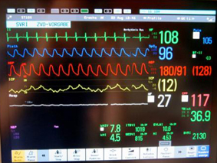
Monitoring

Slide 12
Designing an Adaptive Plan
I.
Setting the Stage
V. Preparing the Trigger Responses
Constraints
Objectives
Options set
Others’ actions
Unforeseen events
Definition of
Changing preferences
success
ll
.
Assembling a Basic Plan
[Based on W.E. Walker, S.A. Rahman, J. Cave (2001). “Adaptive policies, policy analysis, and policymaking”, European Journal of Operational Research 128 : 282-289]
Necessary conditions
Actions
for success
Certain
vulnerabilities
Mitigating actions
Vulnerabilities
Uncertain
or opportunities
vulnerabilities
Hedging actions
Reassessment
Shaping actions
Certain
opportunities
Seizing actions
Corrective actions
III.
Increasing the Robustness of the Basic Plan
Defensive actions
Signposts
Triggers
Capitalizing actions
lV. Setting up the Monitoring System

Slide 13
Implementing Adaptive Policies
Implement the basic policy, together with mitigating, hedging, shaping and seizing actions
Prepare for corrective and defensive actions
  Ensure that they are possible and available if needed
Institutionalize the monitoring of signposts and triggers

Slide 14
Case: Scenarios Nijmegen 2035
Problem: Improve future proofness of the current plans of the Nijmegen municipality for the long term (i.e. 2035)?
Approach:
  Develop scenarios , i.e. a description of the conditions under which the city of Nijmegen that is to be analyzed, designed, or evaluated is assumed to perform.
  Test the current plans in terms of robustness for alternative futures (scenarios) and goals; choose robust plan (within the bandwidth of those scenarios)
  (Identify the vulnerabilities and opportunities of this robust plan, i.e. in which futures will this plan fail)
  (Further improve the robustness by specifying anticipatory measures)

Slide 15
Preliminary observations
Governance aspect:
  Suggestion to invite a broader public during the sessions
  New governance arrangements between actors due to adaptive actions?
  New governance arrangements because of monitoring activities?

Slide 16
Role of citizens in monitoring (Quay, 2010) and/ or integration (Guston, 2008)

Slide 17
Context and focus
Urban policy making is getting increasingly complex:
  Uncertainty on important issues
  Multi-level governance, especially multi-stakeholder participation
Yet urban policy making becomes increasingly important

Slide 18
Main questions
How does anticipatory governance take place in decision making processes at the urban level, focussing upon:
  How do citizens fill in their role in (monitoring or integration) anticipatory governance?
  How does the goverment respons to this new role?
  How can it play a role in anticipating futures and thinking about the long term? More specific, is it a chronological process, or do the steps rather take place simultaneously and might the results influence and strengthen each other?

Slide 19
Concepts: anticipatory governance
Anticipatory governance according to Quay (2010) is a three step process (anticipation and futures analysis, creating flexible adaption strategies and monitoring & action)
Serrao-Neumann et al. (2013) adjust this framework by making the steps chronological
Focus here is upon monitoring

Slide 20
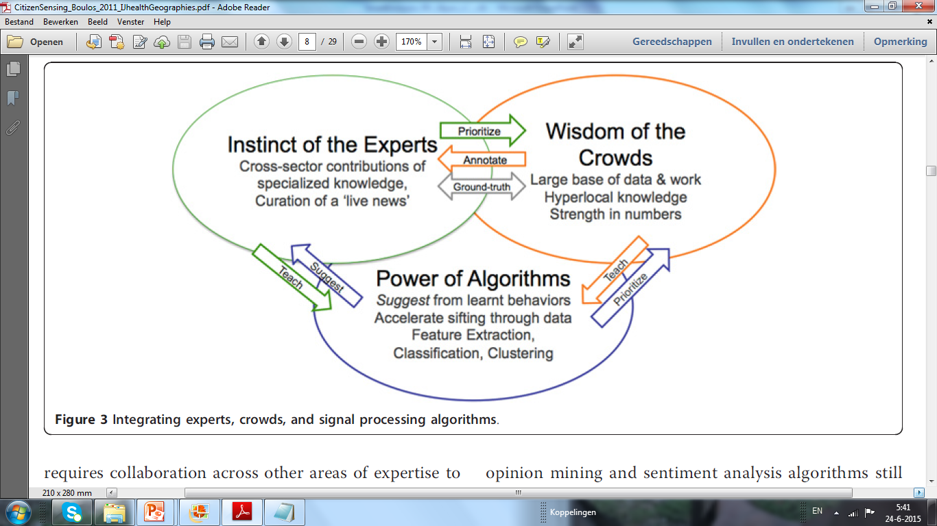
Concepts: role of citizens (1)
In planning literature, much about participatory planning
Literature on sensors and citizen’s expertise is emerging
Source: Boulos et al. (2011)
Notes:
Boulos et al (2011) Crowdsourcing, citizen sensing and sensor web technologies for public and environmental health surveillance and crisis management: trends, OGC standards and application examples. In: Int Journal of Health Geographics, 10:67.
Explanation from the paper of Boulos about citizen sensing in the context of health surveillance and crisis management:
[LC: Boulos has a long explanation of this figure, in essence it is about letting the strengths of each “sphere” counterbalance the weaknesses of each sphere: Fuse citizen’s intelligence with expert knowledge to make ‘ground truth’ pictures quickly, and use sensed data and algorithms to filter and optimize information. In underneath part of the article, Boulos et al explain the strengths and weaknesses of each sphere.]
(NB I made the relevant parts in underneath piece of text cursive ).
Bringing together the best of experts, crowds, and
machines
One needs to adopt concurrently a set of three practices
for rapid analysis of large volumes of information:
expert analysis, crowdsourcing (especially engaging networks
of professionals in the health system, who have
local knowledge and can do contributions from their
perspectives, not only ‘public crowds of citizens’) and
machine learning. Each of these three items provides
useful data by itself, but used together, they are able to
counter-balance each other’s strengths and weaknesses,
as shown in Figure 3.
Experts make decisions based on understanding data
sources and the mechanics behind health events (e.g.,
transmission modes of diseases, time lags (incubation
period) between infection and (onset of) symptoms,
knowledge of the typical behaviour of patients, etc.).
These experts can very rapidly generate a hypothesis
about an unfolding event or validate, confirm or deny a
certain characterisation. They also have in-depth knowledge
about response protocols and sources of specialised
data.
Experts, however:
• Are few in number and their time is precious;
• Are increasingly specialised, which allows them to
make blink decisions correctly within their domain, but
requires collaboration across other areas of expertise to
contribute a ‘complete picture’ of a situation; and
• May have little local knowledge about local behaviours
in an area where there may be an unfolding
outbreak.
During the 2009 H1N1 influenza pandemic crisis, it
was clear that the Internet and open data played a big
role in capturing a ground truth of how people were
reacting to the pandemic. Tamiflu (Oseltamivir, an antiviral
drug) availability, hospital queue lines, and impact
on medical care provider stress levels were all extensively
blogged, tweeted, and shared via listservs and
other modes of communication. This provided greater
quantity and quality of information than was expected.
Information from ‘crowds’ and communities of practice
can be very useful, with the following considerations
in mind:
• Twitter and other social media can disseminate both
valid and invalid information [74]. Crowdsourced ‘data’
have a tendency to be resistant to nuance and correction;
especially in social media, once a meme snowballs
in the ‘echo chamber’, it can be very hard to correct (or
‘counter-tweet’) and the crowd is sometimes not so fast
at changing course;
• Crowds often have no immediate way to discern
truth from falsehood; what gets propagated is the ‘popular’
opinion shaped by the most prominent personalities,
beliefs and agendas of the individuals in the ‘crowd’.
Technically-savvy citizens also introduce an interesting
skew in the velocity with which their ideas spread and
get shared; even more if there are political agendas
involved. For example, tools to visualise H1N1 spread
became popular more on the basis of visual appeal than
quality of the data or the processes used to generate or
validate them (but opinions are not all too bad, and
opinion mining and sentiment analysis algorithms still
have an important place in some Social Web mining
and surveillance applications [75]);
• Crowds are prone to add opinion to data; which
sometimes sticks more than the credible data themselves.
Separating opinion and credible data through
expert interpretation and curation, both centralised and
decentralised, is important (in de-centralised curation,
specific statements of fact expressed or extracted from
citizen-generated information are validated, refuted, and
expanded by the citizens themselves in a more distributed
system (cf. concepts of peer reviewing and darwikinism
[76]); and
• There are a few agencies (e.g., [77]) that have organisational
or procedural channels specifying how to aggregate
and incorporate information emerging on the
Internet in decision making.
As for algorithms, in the business and finance sector,
Derwent Capital and Bloomberg (with WiseWindow)
are said to be already using Twitter mining algorithms
in making useful stock market predictions with good
accuracy [78,79]. Machine learning algorithms can be
used to extract useful information from large amounts
of data. Most machine learning applications in health
use supervised learning, a subset of machine learning
that uses ‘feedback’ (from humans or other systems) to
improve its learning over time. Common uses of
machine learning include:
• Feature extraction: For example, extracting ICD-9
(International Classification of Diseases) codes and
references to syndromes or diseases from text, as well as
interpreting text to infer time, location, people, etc.
referred to in it;
• Classification: Being able to classify, group or tag
information based on some explicit or unknown criteria;
• Clustering: Machines can process vast amounts of
data and present correlations and proximities that
escape the human eye and brain, sometimes discovering
non-obvious correlations between variables; and
• With large amounts of data available, it is not even
necessary to have a deep understanding of the relationships
within the data themselves: machines can on their
own distil the noise from the relevant correlations
through successive optimisation.
However, machine learning has shortcomings of its
own, when used in isolation:
• Some algorithms process signals in a way that is
more specific than sensitive, meaning that important
signals may be missed (false negatives). A combination
of algorithms is important to draw different types of
events and event features from undifferentiated data;
understanding which algorithms, through experience, is
essential;
• Algorithms need to be thoroughly validated and
tested; and each new situation may place a new challenge
on a given algorithm that may not allow the
assessment of the quality of the algorithm in real-time;
• Algorithms need data to train and feedback to learn.
Sometimes this learning phase makes it hard to get
value ‘out of the box’;
• Humans have a tendency to become “lazy” over time
and experience with accepted algorithms, where overdependency
and improper cross-checks of an algorithm’s
results may result in missed or misinterpreted
signals;
• Low social acceptance in some cultures of systems
that do not function in a way that is predictable or
describable by a human; and
• Past misuse of machine learning with little understanding
of the cognitive science underpinnings of
human communication has led users to fear (and AI
(Artificial Intelligence) experts to boast) that an algorithm
could be put on par with a human. State-of-theart
cognitive theories (Winograd, Flores, etc.) show that
commitments (statements of fact) can only be provided
by humans; and therefore provide a better framework
for understanding where machine learning fits. In simpler
terms: - Should an algorithm declare a health emergency?
No - because there is no commitment behind it.
Can an algorithm help present data to an expert or
authority with ‘suggestions’ and ‘red flags’, and then the
authority can declare a health emergency? By all means,
and this is a smarter design.
The vision of pervasive sensing through ‘citizens as sensors’
poses considerable challenges in terms of interoperability
involving data formats, service interfaces,
semantics and measurement uniformity.

Slide 21
Concepts: role of citizens (2)
1. Inclusive Citizen Sensing:
        Transparency and democracy (of pollution monitoring)
        Bottom-up approach
        Sensing interface serves as boundary object
2. Smart Governance:
        Connect bottom-up with top-down arrangements
        Connect small cycles (feedback data) and large cycles (info piping through models)
3. Towards Sustainable Cities:
        Support change of daily behavior (shift car traffic to bicycle and electric transport)

Slide 22
Case smart emissions project (1)
From citizens point of view
Forming a citizen-sensor-network
Retrieving information about the air quality
Connecting the physical world and the social world by creating a shared language
‘Face validity’ factual measurements help creating a story and sense-making

Slide 23
Case smart emissions project (2)
From government point of view
Citizens are seen as partners in the project
Informed dialogue with citizens
Empowering citizens feeding a bottom-up process
Shared language between experts, policy makers and citizens

Slide 24
Preliminary observations
AG | Citizen-Sensor-Network
Future Analysis
Adaptation Strategies
Monitoring & Action
Create awareness of making futures by integrating monitoring by citizens, provinding them with scenario’s and weak signals?
Notes:
anticipation and futures analysis, creating flexible adaption strategies and monitoring & action

Slide 25
Experts
Citizens
Policy makers

Slide 26
monitoring
Strategies
Futures studies

